Slide 1
Housing Price DatasetAnalysis
Phase 2 Project
Wambui Mutero – Part Time

Slide 2
Overview
We collected data on over 21,000 home sales in King County between May 2014 and May 2015. The data includes information on the location, size, age, and condition of each home, as well as the sale price and other important factors. From our analysis we will find correlations between the factors which will help our shareholders (Homebuyers) make informed decisions when purchasing homes in that location.
Our objectives in this analysis is to:
Identify the key factors that influence house sale prices.
Develop a pricing model to accurately predict house sale prices
Evaluate the impact of different variables on house sale prices. This can provide valuable insights into which variables have the most significant impact on the real estate market.
We will answer the following questions:
What are the most important factors that influence house prices?
How have house prices in the county changed over time?
Are there any potential biases or limitations in the data that could affect the results of analysis?

Slide 3
Outline
Business Problem
Data
Methods
Results
Conclusions

Slide 4
Business Problem
Describe the business problem here;
The Business problem that this project wants to solve is how to guide a homeowner/homebuyer when purchasing a home in the Northwestern county based on characteristics such as number of bedrooms, location, square footage, and other factors.
With the analysis conducted it will help determine the factors that have the greatest impact on the price of a house which will then allow homeowners to make informed decisions when buying the house.

Slide 5
Data
The data provided was forked and cloned from https://github.com/learn-co-curriculum/dsc-phase-2-project. It was gathered in September, 2020. It included the column_names as well as the kc_house_data.csv . The CSV file has 21597 rows and 21 columns. It contains the following features:
i)id - House identification
ii)date - date house was purchased
iii)price - house prices
iv)bedrooms - number of bedrooms in the house
v)bathrooms - number of bathrooms in the house
vi)sqft_living -square footage of the home
vii)sqft_lot - square footage of the lot
viii)floors - number of floors in the house
ix)waterfront - house location near an area of water
x)view - house has been viewed
xi)condition grade - overall condition of the house relative to its age
xii)sqft_above - square footage of house apart from basement
xiii)sqft_basement - square footage of the basement
xiv)yr_built - year the house was built
xv)yr_renovated - year the house was renovated
xvi)zipcode - code numbers assigned by postal service
xvii)lat - latitude coordinates
xviii)long - longitude coordinates
xix)sqft_living15 - average size of interior housing living space for the closest 15 houses, in square feet
xx)sqft_lot15 - average size of the lot space for the closest 15 houses, in square feet

Slide 6
Methods
The following methods were used for data preparation of the above data:
1. Data Cleaning: This involved removing any duplicates, missing or irrelevant data points from the dataset. For example, dropping rows with missing values, removing columns with too many missing values, and eliminating duplicate rows.
2. Data Transformation: This involved converting the data into a more usable format, such as changing categorical variables into numerical ones.
3. Outlier Detection: This involved identifying outliers in the dataset that would cause potential biases.
4. Data Visualization: This involved visualizing data on scatterplots, heat maps, histograms, bar graphs to see the correlation between pricing structure and other factors considered.

Slide 7
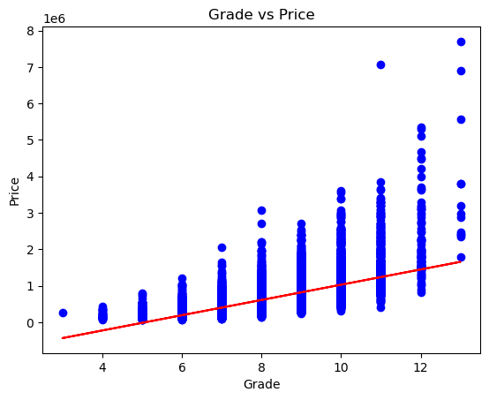
Results
Present the results of your analysis or modeling here. Should include evaluation of how well your results solve the business problem.
One of the most interesting findings from our analysis is the strong correlation between grade and home prices. As you can see in this map, homes of a higher grade tend to sell for much higher prices than those of a lower grade.
This is an important consideration for homebuyers looking to purchase in King County, as they may need to adjust their expectations based on the grade of the home they are looking to purchase.

Slide 8
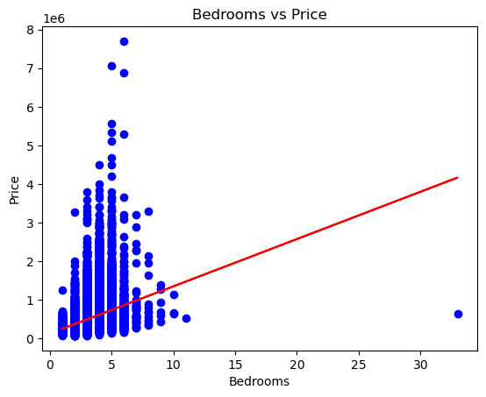
There does not appear to be a strong relationship between 'price' and 'bedrooms', which is somewhat surprising since more bedrooms are often associated with larger and more expensive homes.
However, in this case we can see that you can have a house with maybe 5 bedrooms that will cost less compared to a 3-bedroomed home. This might be dependent on other factors such as the grade of the house, condition of the house, year the house was built etc

Slide 9
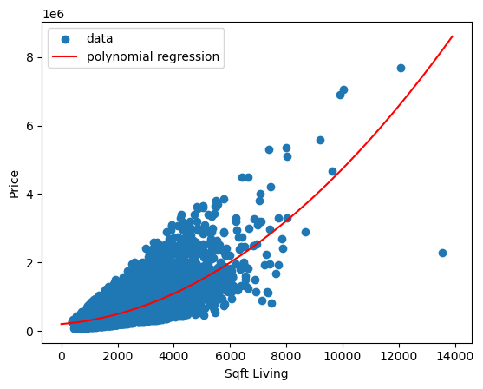
We can conclude that there is a non-linear relationship between the 'sqft_living' feature and 'price' target variable in the dataset.
The polynomial regression line captures the general trend of the data, showing an upward trend for 'price' as 'sqft_living' increases.
Here we conclude that larger homes tend to be more expensive.

Slide 10
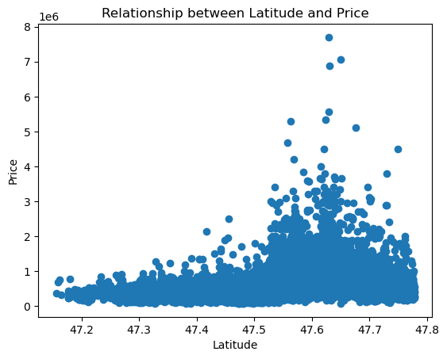
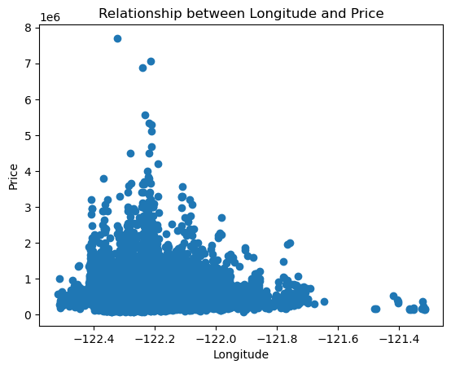
The scatter plots above allows us to visualize how the location of the houses (as defined by their zipcodes) relates to their prices.
We can see that there is a wide range of prices across different zipcodes, with some areas having much higher mean prices than others. This suggests that location is also an important factor in determining house prices.

Slide 11
Conclusions
The housing dataset analysis has provided some interesting insights into the factors that influence the sale price of houses in the King County area. From our analysis, we have seen that location is a factor considered in determining the price of a house, with houses in areas with higher median incomes generally selling for more.
Additionally, the size and condition of the house are also important factors, with larger houses and those in better condition tending to sell for more.
Overall, our analysis suggests that the housing market in King County is fairly predictable and that there are certain factors that buyers should consider when looking to purchase a home in the area. By taking into account factors such as location, size, grade and condition, buyers can make more informed decisions and ensure that they are getting the best value for their money.

Slide 12
Based on the analysis of the housing price dataset, here are some recommendations:
Grade is a crucial factor in determining house prices. Houses in of certain grades are priced higher than others, so it's important to consider grade of the house when buying house.
The size of a house is also important factors in determining its price. Houses with more square footage tend to be priced higher.
It's important to be aware of potential biases and outliers in the data that can affect the accuracy of the pricing model. Conducting sensitivity analysis and outlier analysis can help identify and address these issues.
It's important to keep track of market trends and adjust pricing accordingly. If the market is experiencing a downturn, it may be necessary to lower prices to attract buyers. Conversely, if the market is booming, it may be possible to increase prices for maximum profit.
Finally, using a robust pricing model like the one developed in this analysis can help ensure accurate and fair pricing for both buyers and sellers. By considering all relevant factors and using statistical analysis to make predictions, the model can help optimize pricing strategies and ensure a successful buy.

Slide 13
Thank You!
Email: gloria.mutero@student.Moringaschool.com
GitHub: Wambui0001

